Slide 1
Progress report
Speaker: Geng-Yun Tien
Advisor: Eric Y. Chuang
Date: 2023/10/25

Slide 2
Works
1
Gene mutation prediction (APC and TP53)
2
Utilize cBioPortal database to explore complete mutation data
3
Finish self-attention model script
4
Graph Neural Network (GNN)
5
Prepare big lab meeting paper presentation

Slide 3
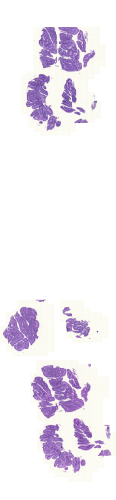
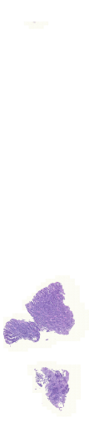
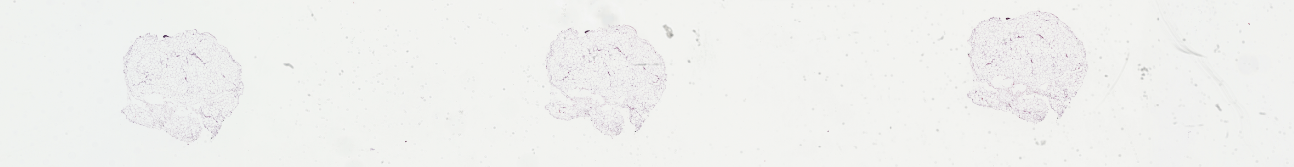
Mutation data
Original 435 WSIs are downloaded. More, exclude samples with inferior in quality (bright, blurry and inconspicuous) and the less tumor patches samples are also removed
Total 424 TCGA-COAD WSIs are used and divided into training, validation and testing set in the ratio of 70%, 10% and 20%
Generate APC and TP53 mutation label
 | APC | TP53
Wildtype | 223 | 222
Mutation | 201 | 202

Slide 4
Gene mutation patch-level prediction – ResNet101
testing | Accuracy | Sensitivity | Specificity | AUC
APC | 0.626 | 0.888 | 0.257 | 0.612
TP53 | 0.628 | 0.726 | 0.495 | 0.662
training | Accuracy | Sensitivity | Specificity | AUC
APC | 0.784 | 0.937 | 0.458 | 0.826
TP53 | 0.696 | 0.79 | 0.578 | 0.767
Gene mutation slide-level prediction – ResNet101
testing | Accuracy | Sensitivity | Specificity | AUC
APC | 0.67 | 0.9 | 0.467 | 0.716
TP53 | 0.72 | 0.732 | 0.711 | 0.734
training | Accuracy | Sensitivity | Specificity | AUC
APC | 0.781 | 0.965 | 0.615 | 0.93
TP53 | 0.777 | 0.816 | 0.742 | 0.847

Slide 5
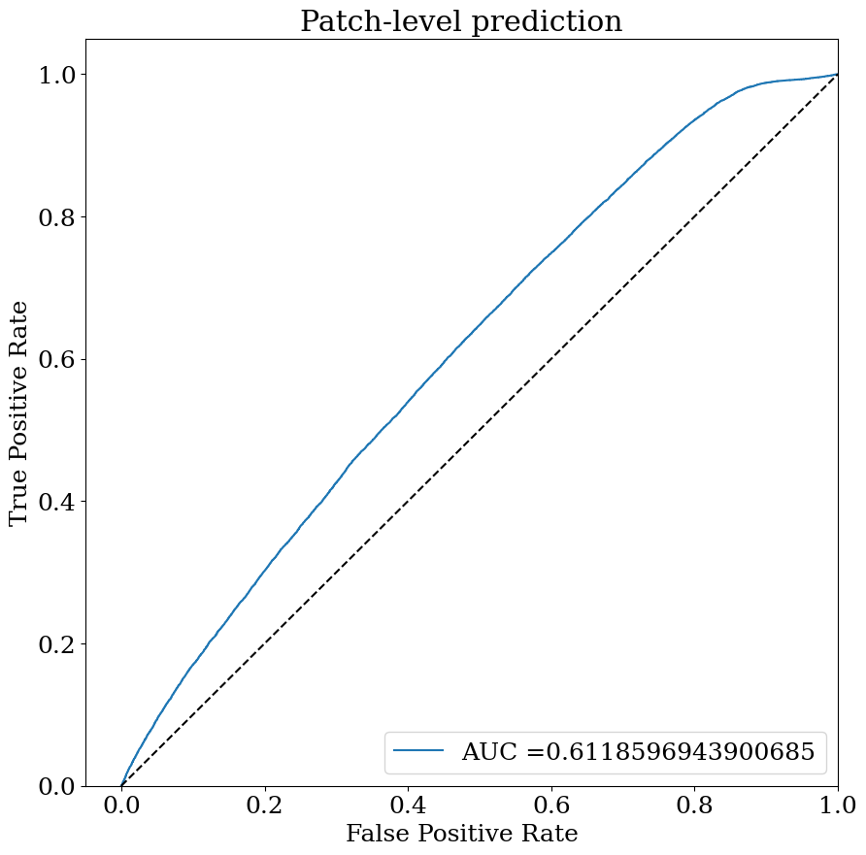
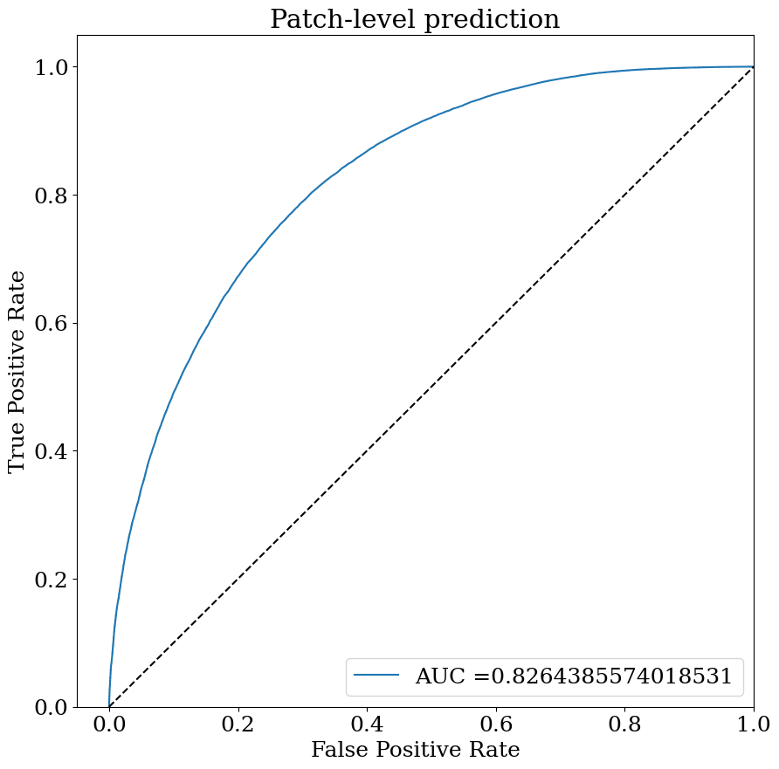
APC patch-level prediction result

Slide 6
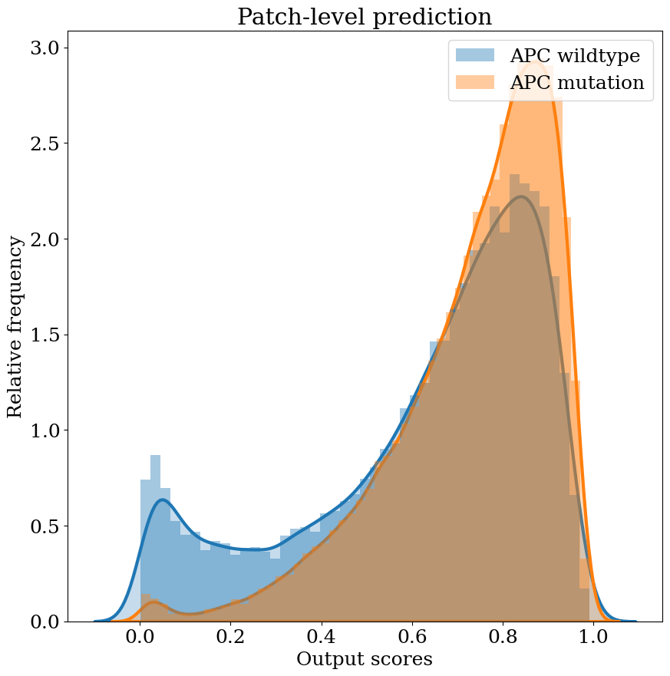
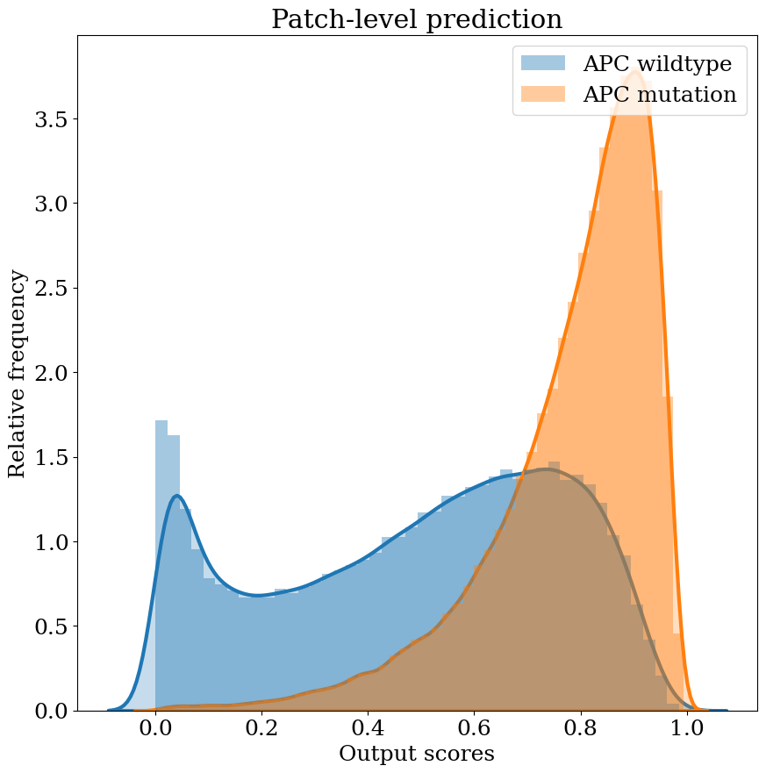
APC patch-level prediction result

Slide 7
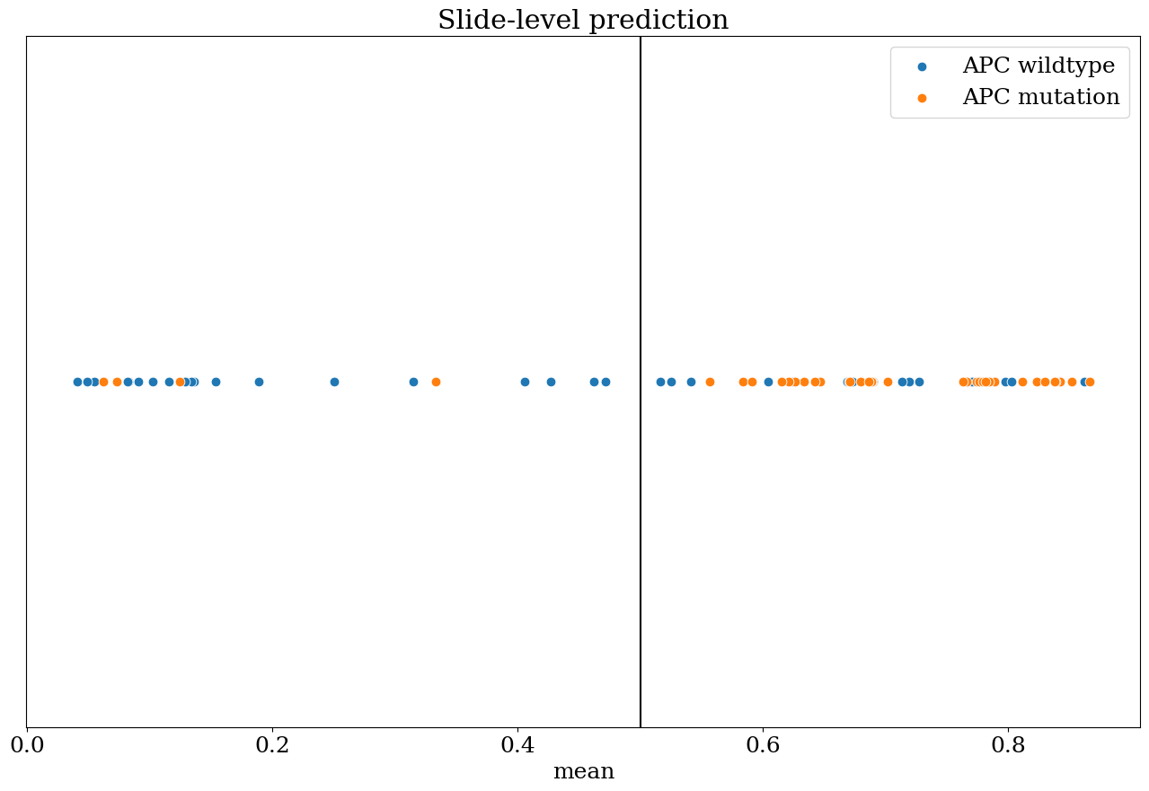
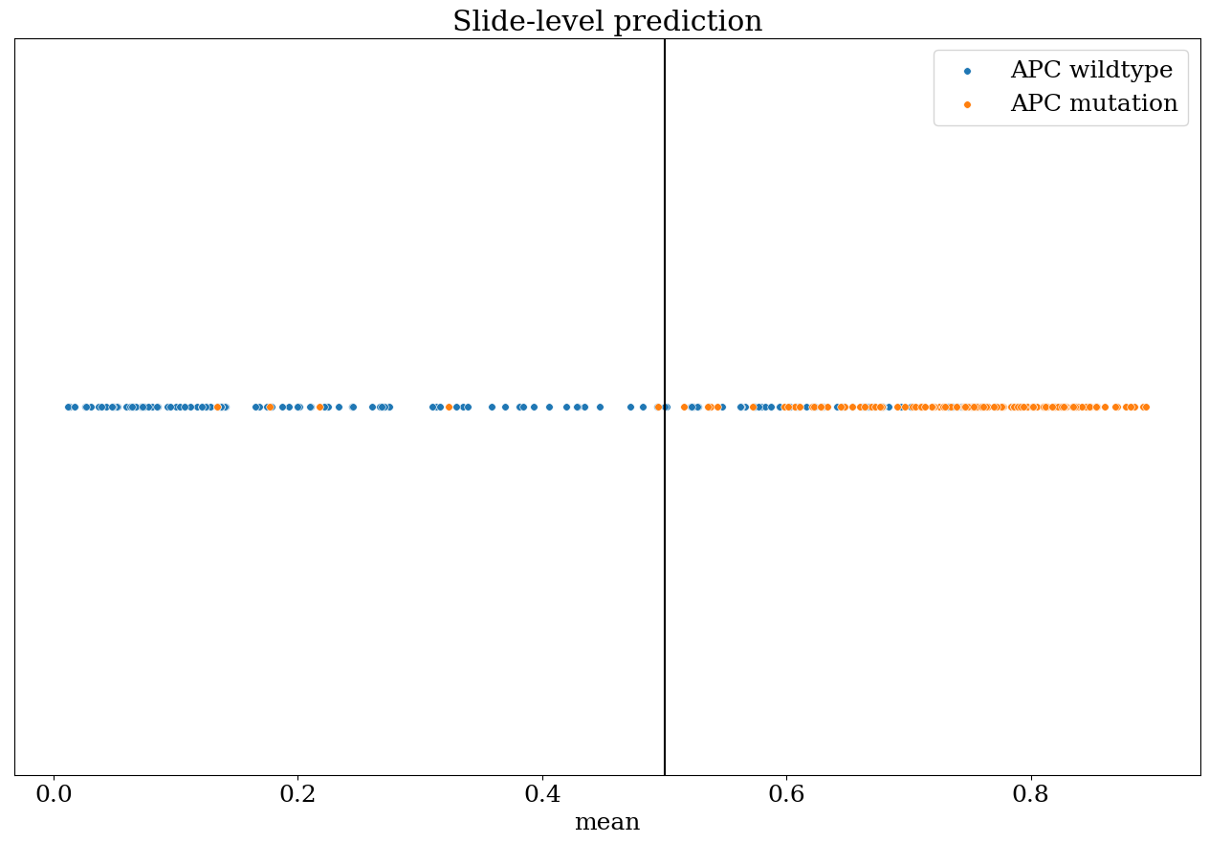
APC slide-level prediction result

Slide 8
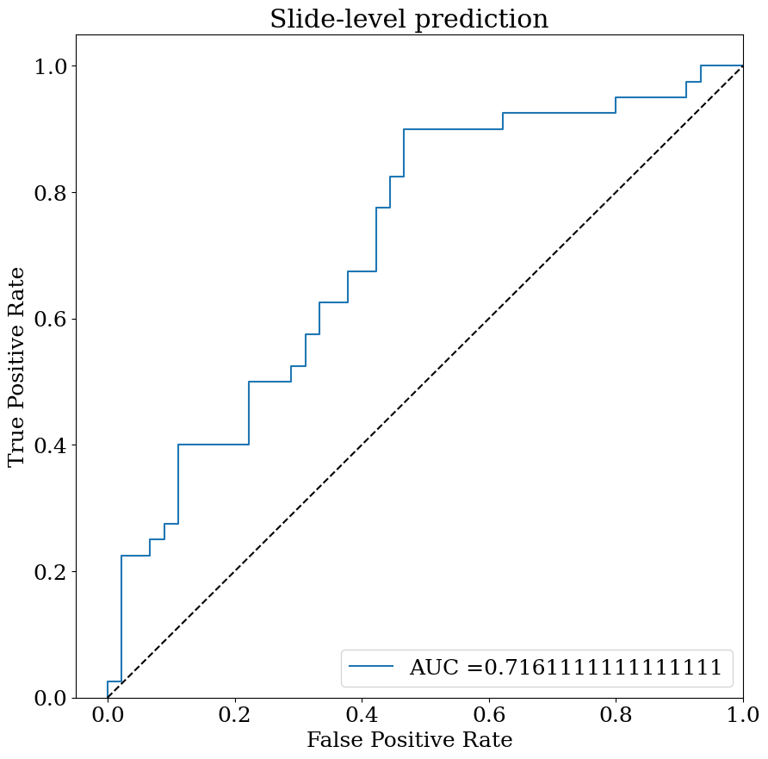
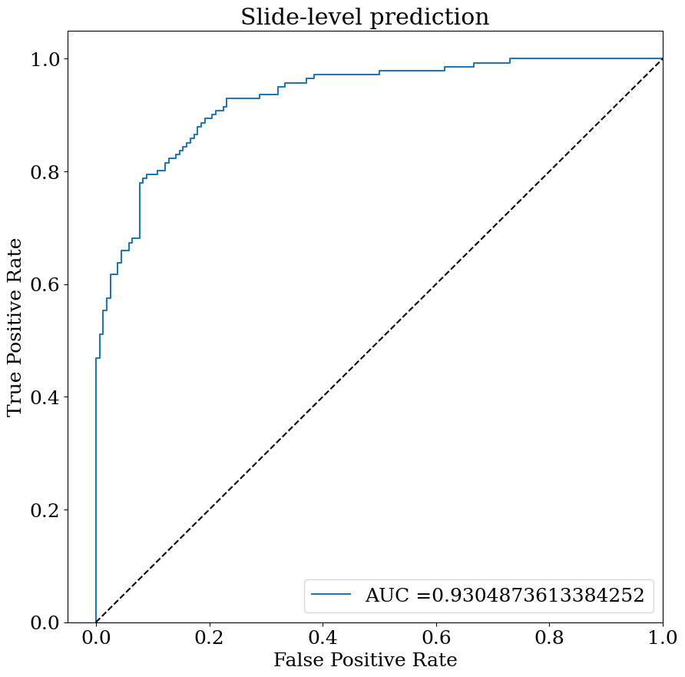
APC slide-level prediction result

Slide 9
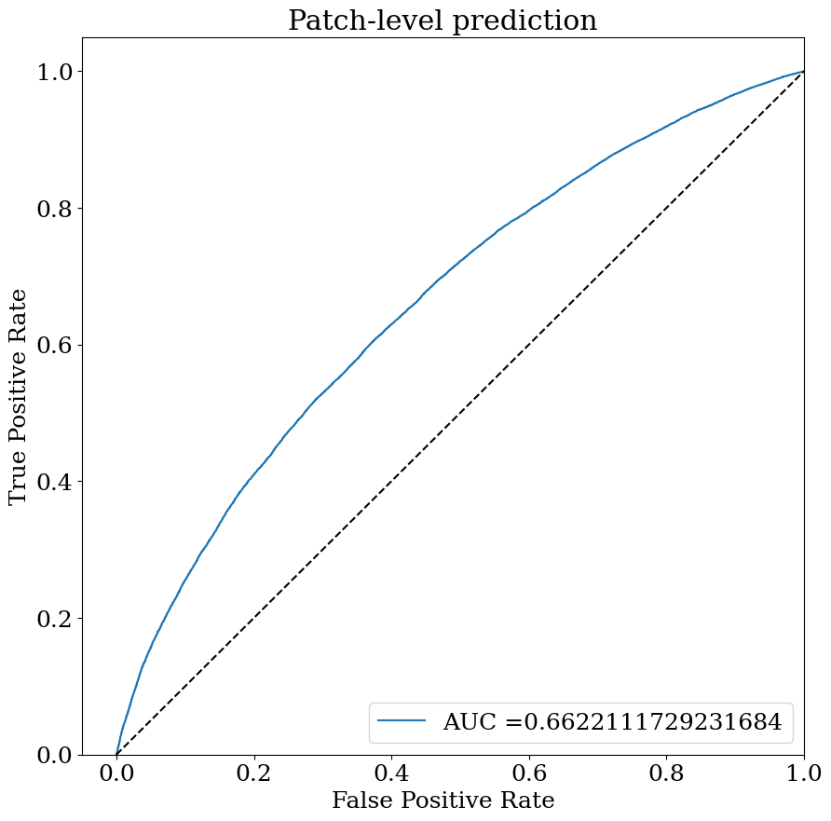
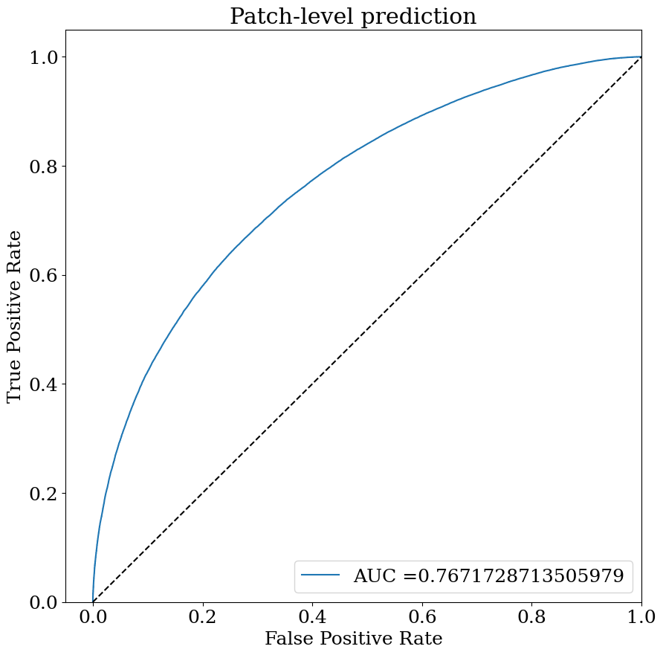
TP53 patch-level prediction result

Slide 10
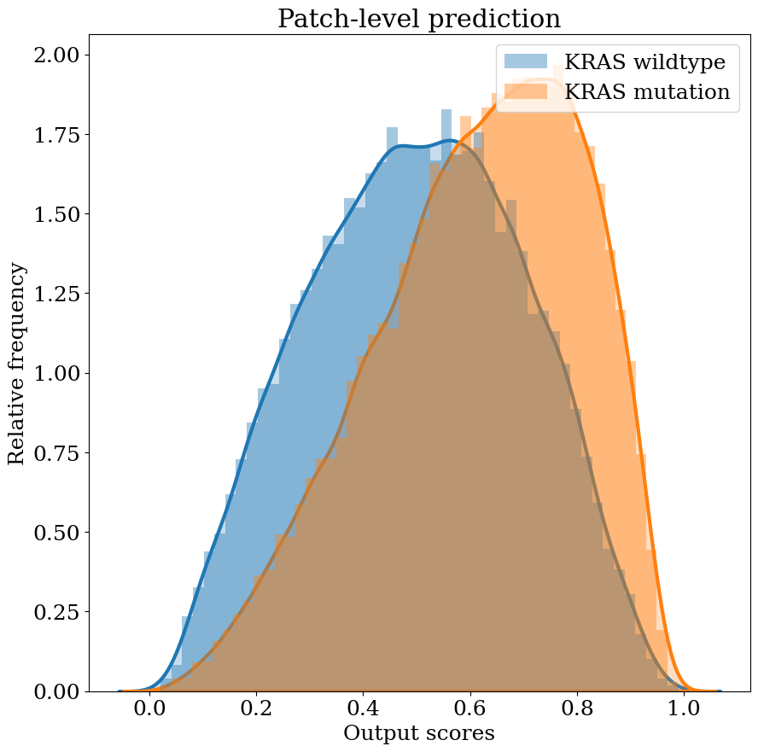
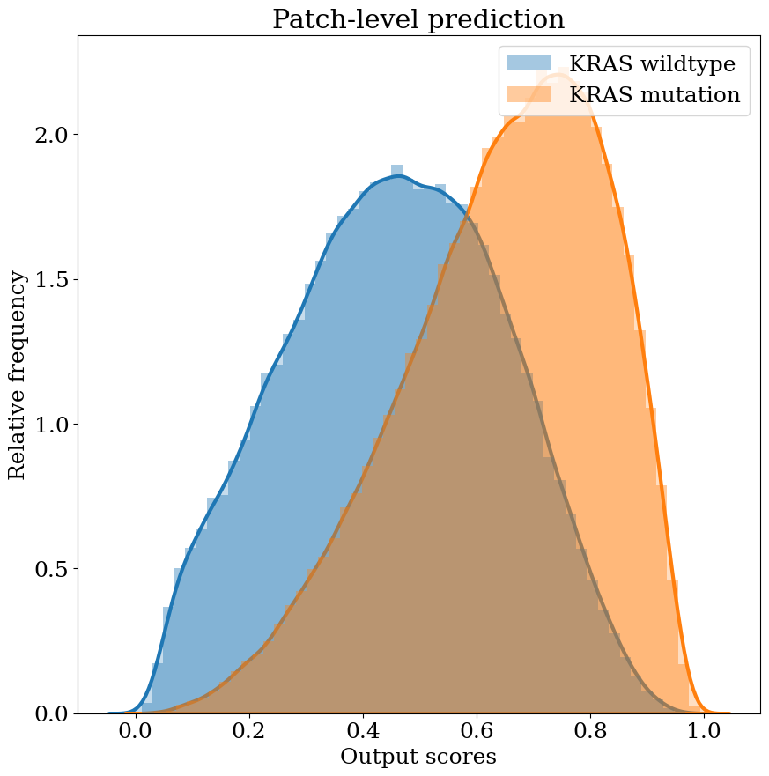
TP53 patch-level prediction result

Slide 11
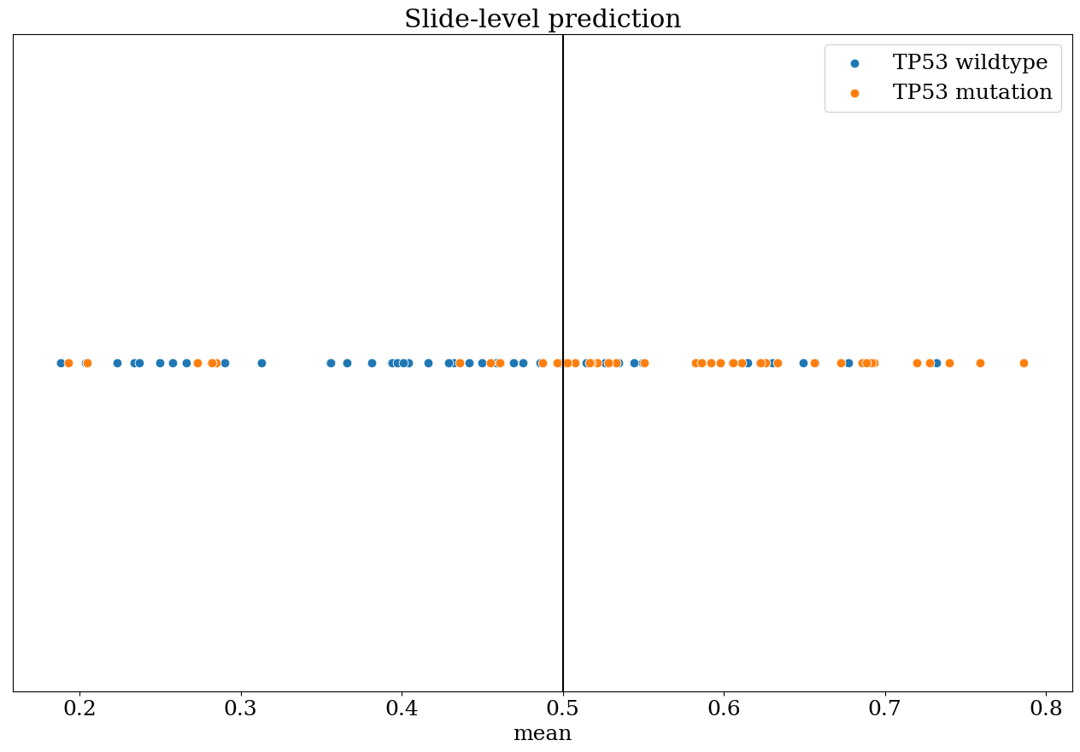
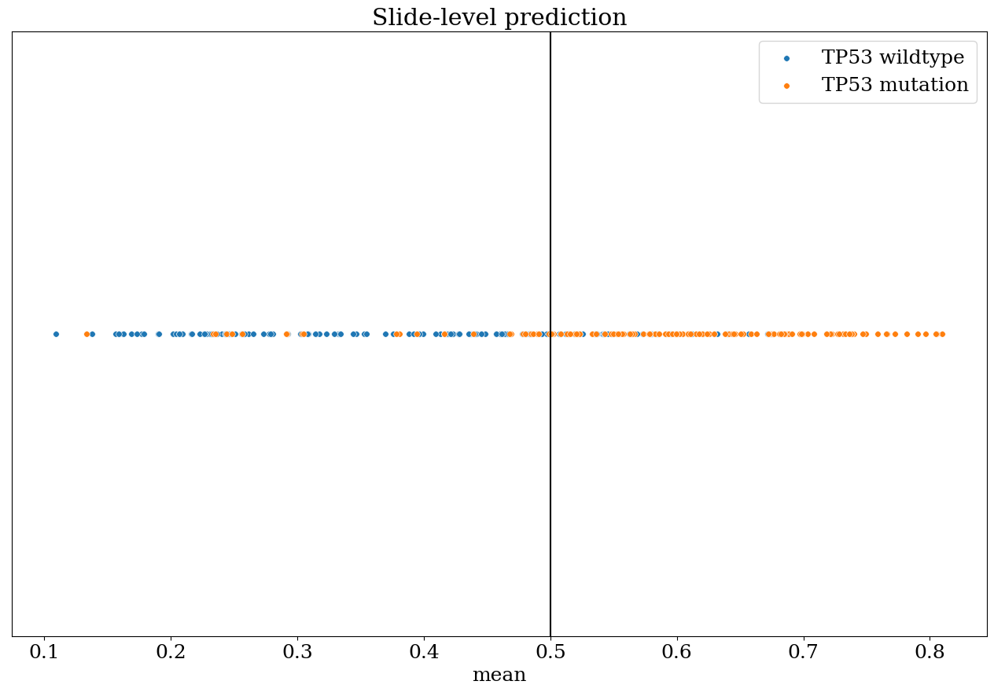
TP53 slide-level prediction result

Slide 12
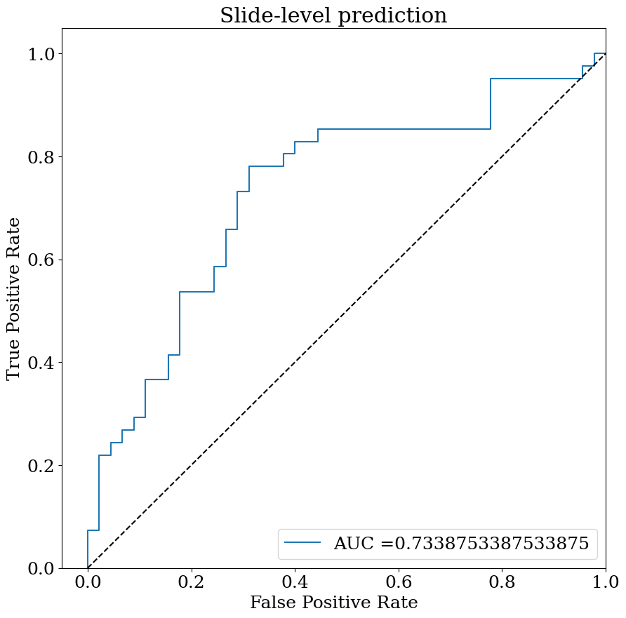
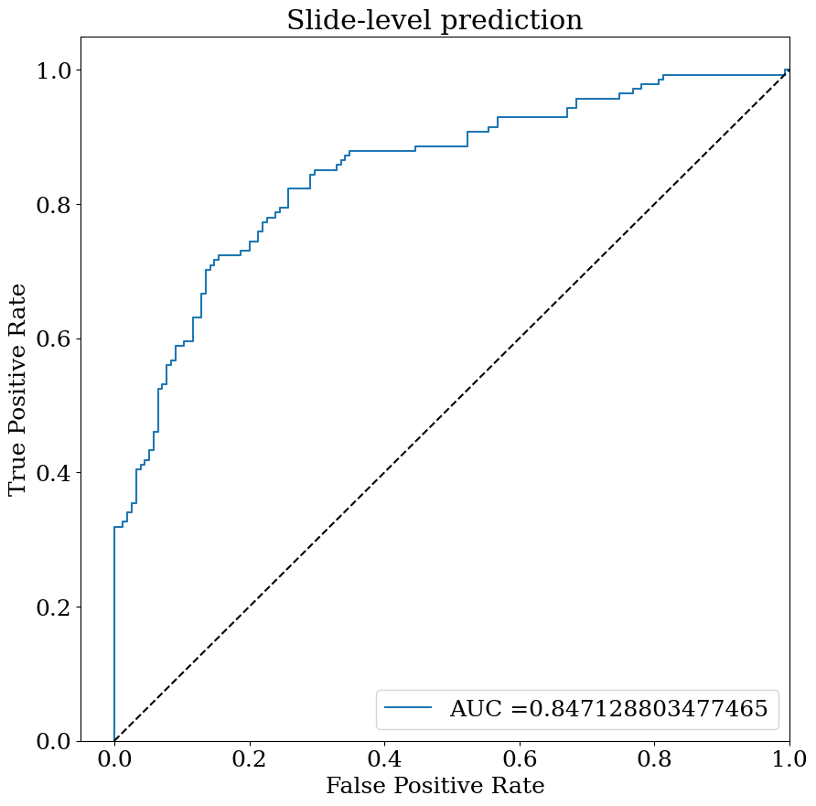
TP53 slide-level prediction result

Slide 13
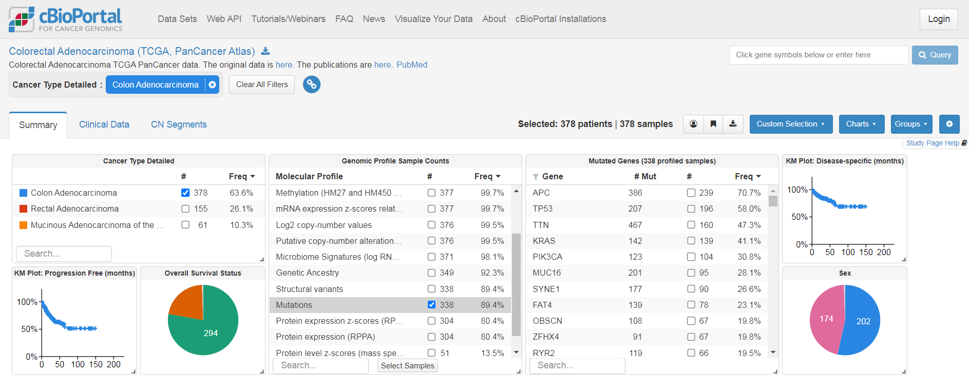
cBioPortal
An open database for omics-relevant data download
We can acquire completed mutation data from several subproject of TCGA

Slide 14
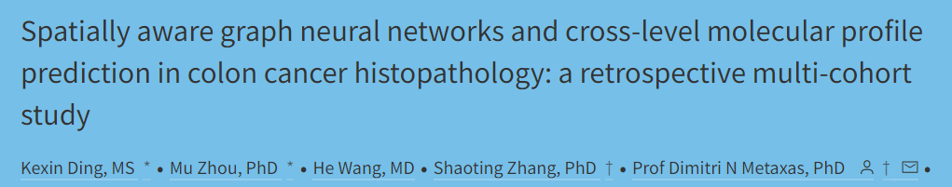

Big lab meeting paper presentation
Journal paper: Lancet Digit Health
Year of publication: 2022

Slide 15
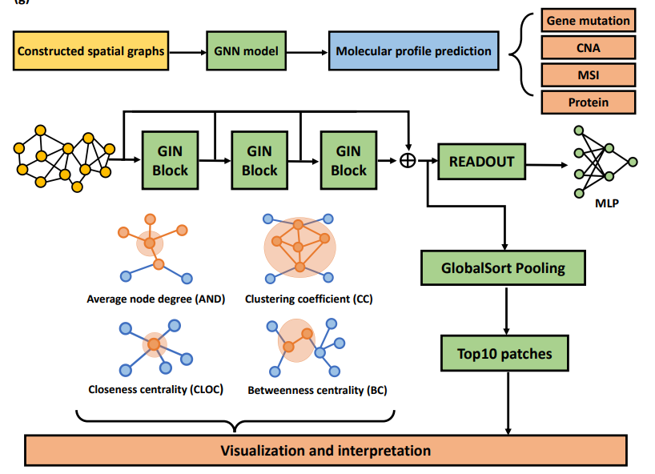
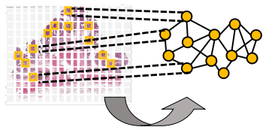
Paper proposed pipeline
a. Spatial graph construction of tumoral tiles
b. The pipeline of the graph networks model training, prediction and interpretation process
Graph construction includes n tumoral tiles as graph nodes and its corresponding spatial grid coordinates
Their attributes are the ResNet18-extracted image features

Slide 16
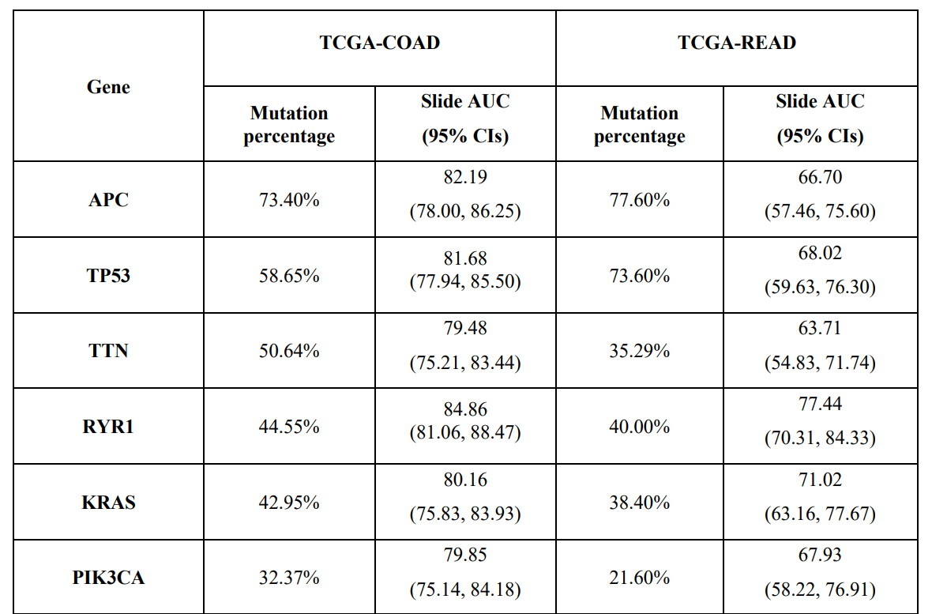
Paper gene mutation prediction results

Slide 17
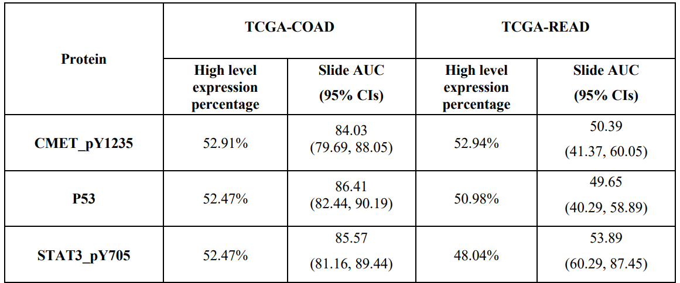
Paper MSI prediction results
MSI | TCGA-COAD | TCGA-READ
Slide AUC (95% CIs) | 83.92 (77.41, 87.59) | 61·28 (53.28, 67.93)
Paper functional protein expression prediction results

Slide 18
Process that we can modify
1
Use Resnet50 trained by SimCLR as feature extractor to substitute pretrained Resnet18 in the paper
2
Revise GNN model architecture
3
Add morphology analysis after visualization and interpretation

Slide 19

Future work
1
Keep improving CNN model performance and try to use others model and predict another gene
2
Finish GNN model training script
3
Finish AACR abstract

